Slide 1


Sécurité Du Logiciel - 2
GI2
Pr. Mohammed NASRI

Slide 2
Vulnérabilités des applications

Slide 3
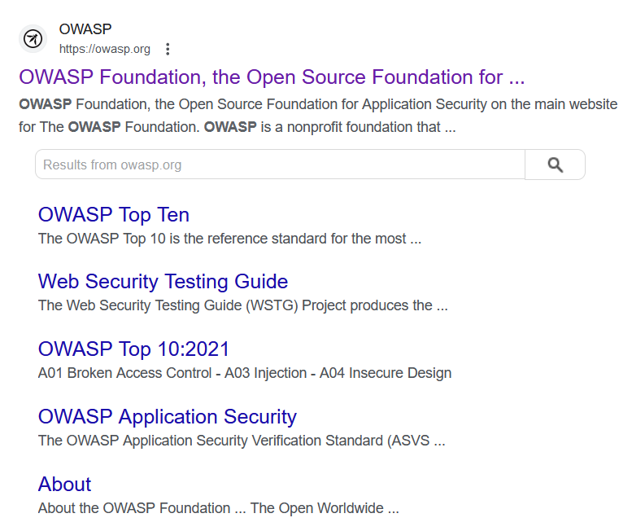
Projet OWASP

Slide 4
Projet OWASP
The OWASP project stands for the Open Web Application Security Project.
It is a nonprofit foundation that works to improve the security of software.
Through community-led open-source software projects, hundreds of local chapters worldwide, tens of thousands of members, and leading educational and training conferences, OWASP provides tools, documentation, forums, and other resources to help organizations, developers, and security professionals understand and enhance the security of web applications and software.

Slide 5
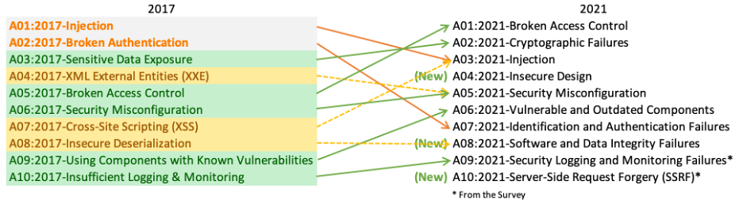
Projet OWASP – TOP 10

Slide 6

Projet OWASP – Zed Attack Proxy (ZAP)
OWASP ZAP (Zed Attack Proxy) is a free, open-source security tool designed for finding vulnerabilities in web applications.
ZAP is intended for use by security professionals and developers alike to help find security flaws in web apps before they are exploited by attackers.
It is one of the most popular tools for security testing of web applications and offers a
range of features for web application security auditing.

Slide 7
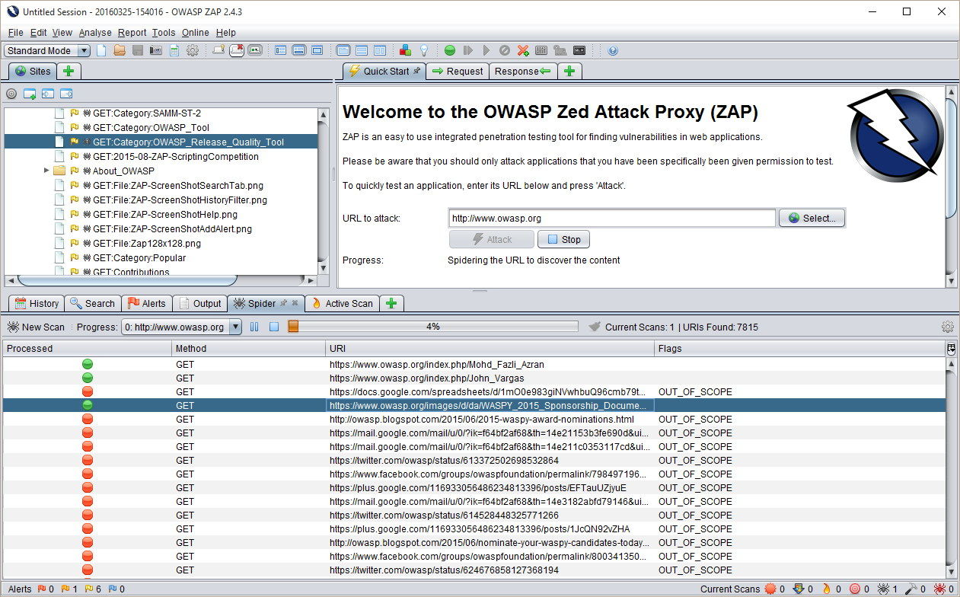
Projet OWASP – Zed Attack Proxy (ZAP)
OWASP ZAP (Zed Attack Proxy) is a free, open-source security tool designed for finding vulnerabilities in web applications.
ZAP is intended for use by security professionals and developers alike to help find security flaws in web apps before they are exploited by attackers.
It is one of the most popular tools for security testing of web applications and offers a
range of features for web application security auditing.

Slide 8
ZAP : Key features
Automated Scanner: It can automatically find security vulnerabilities in web applications.
Manual Testing Support: It provides tools that help manually test for security vulnerabilities.
Spidering and AJAX Spidering: It can crawl web application to automatically discover its pages and functionalities.
Active and Passive Scanning: Passive scanning listens to traffic between the browser and the web application to identify issues without sending new requests, while active scanning sends requests to the application to find vulnerabilities.
Authentication Support: It supports multiple forms of authentication, making it possible to test applications that require login.
REST API: It offers a REST API that allows for integration with other tools and automation of security testing processes.
Extensible: Users can extend ZAP by writing their own plugins or scripts in several programming languages.

Slide 9
Vulnérabilité 1 : Broken Access Control

Slide 10
Broken Access Control, What?
Broken Access Control refers to a security vulnerability where restrictions on what authenticated users are allowed to do are not properly enforced.
This can result in unauthorized access to sensitive data or functionality within an application.
Essentially, it means that users are able to perform actions or access resources that they shouldn't be able to, due to flaws in the access control mechanisms.

Slide 11
Broken Access Control, examples and impact
Direct Object References: When an application exposes internal implementation objects, such as database keys or file paths, in its URLs or parameters, allowing attackers to manipulate those references to access unauthorized data.
Insecure Direct Object References (IDOR): Similar to direct object references, IDOR occurs when an application fails to properly authenticate or authorize users when accessing sensitive resources. Attackers can exploit this vulnerability to access other users' data or perform unauthorized actions.
Missing Function-Level Access Control: This vulnerability occurs when an application fails to properly enforce access controls on specific functions or actions. Attackers may be able to access administrative functions or sensitive operations that should only be available to privileged users.
Privilege Escalation: In some cases, users may be able to escalate their privileges within an application by exploiting vulnerabilities in the access control mechanisms. For example, an attacker with limited privileges may find a way to gain administrative access by bypassing authentication or authorization checks.

Slide 12
Broken Access Control, prevention
Implement Proper Authentication: Ensure that users are properly authenticated before accessing sensitive resources or functionalities. Use strong authentication methods, such as multi-factor authentication (MFA), to verify users' identities securely.
Enforce Authorization Controls: Implement fine-grained authorization controls to restrict access to specific resources or functionalities based on users' roles, privileges, or other attributes.
Use Secure Session Management: Implement secure session management practices to prevent session hijacking or fixation attacks. Use secure cookies, enforce session timeouts, and regenerate session identifiers after authentication to mitigate session-related vulnerabilities.
Protect Sensitive Data: Apply encryption and data masking techniques to protect sensitive data both at rest and in transit. Implement access controls to ensure that only authorized users can view or modify sensitive information.
Implement Secure Direct Object References: Avoid exposing internal object references, such as database keys or file paths, in URLs or parameters. Instead, use indirect references or implement access controls to prevent unauthorized access to sensitive resources.

Slide 13
Vulnérabilité 2 : Cryptographic Failures

Slide 14
Cryptographic Failures, What?
Previously known as Sensitive Data Exposure. It lead to unauthorized access to sensitive data due to issues like:
Inadequate Encryption: Using weak or outdated encryption algorithms that can be easily broken by attackers, leading to data breaches. (MD5, SHA1, DES, 3DES, WEP, etc.)
Improper Implementation: Correct and strong encryption algorithms might be in place, but they are implemented incorrectly. Common mistakes include using default or weak keys.
Lack of Encryption: Failing to use encryption for sensitive data in transit (such as using HTTP instead of HTTPS) or at rest, leaving the data exposed to potential interception or unauthorized access.

Slide 15
Cryptographic Failures, prevention
Use strong and modern Encryption algorithms: bcrypt, scrypt, argon2 for now. Avoid MD5, SHA1 and DES. And regularly review the new in this field.
Apply Hashing/Encryption in Rest (encryption) and Transit (HTTPS) and avoid writing custom cryptographic algorithms or implementations. Rely on well-tested libraries and frameworks.
Follow Cryptographic Best Practices :
Apply salting and consider adaptive hashing functions like bcrypt, scrypt, or Argon2 for password storage, as they offer additional resistance to brute-force attacks.
Validate input data to prevent cryptographic vulnerabilities such as padding oracle attacks.
Keep cryptographic libraries up to date to mitigate vulnerabilities from known exploits.

Slide 16
Cryptographic Failures, prevention
Conduct Regular Audits and Penetration Testing to identify and remediate potential cryptographic weaknesses in your applications.
Educate developers to ensure that they are aware of the importance of cryptographic security and understand how to implement cryptography securely. Provide resources and training on secure coding practices and the latest in cryptographic standards and vulnerabilities.

Slide 17
A word on “Salting”
Salting passwords is a crucial step in securely storing passwords, as it adds an extra layer of security by ensuring that even identical passwords will hash to different values.
This process helps protect against rainbow table attacks and increases the complexity for attackers attempting to crack the stored passwords.
How to ?
Generate a unique salt for each password : hnhdgsuejf
Concatenate the salt and the password : hnhdgsuejfazerty
Hash the salted password: 4b575f10dd24685100a79bc51481193c
Store both the salt and the password: hnhdgsuejf 4b575f10dd24685100a79bc51481193c

Slide 18
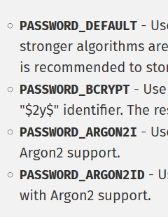
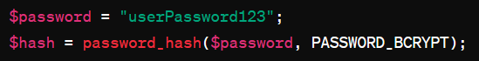
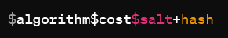
A word on “Salting” (2)
These 4 steps are generally implemented with native functions such as password_hash or password_verify

Slide 19
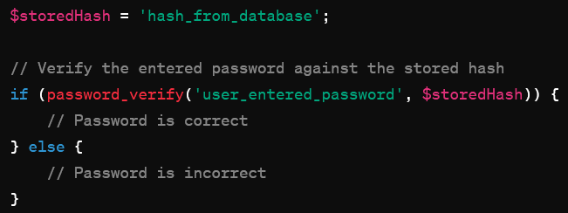
A word on “Salting” (3)
To verify a password against an already stored one:

Slide 20
Vulnérabilité 3 : Injection SQL

Slide 21
SQL Injection, What?
SQL Injection (SQLi) is a type of security vulnerability that occurs in an application's database layer.
This vulnerability allows an attacker to inject malicious SQL queries into the input fields of an application, which are then executed by the database server.
Since SQL commands are executed with the same privileges as the application, this can lead to unauthorized access to sensitive data, manipulation or destruction of data, and potentially, control over the database server itself.

Slide 22
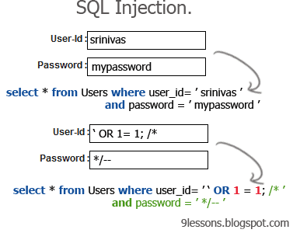
SQL Injection, What?
SQL Injection (SQLi) is a type of security vulnerability that occurs in an application's database layer.
This vulnerability allows an attacker to inject malicious SQL queries into the input fields of an application, which are then executed by the database server.
Since SQL commands are executed with the same privileges as the application, this can lead to unauthorized access to sensitive data, manipulation or destruction of data, and potentially, control over the database server itself.

Slide 23
Injection SQL, impact
Data Breach: Unauthorized viewing of user lists, personal data, or confidential information.
Data Loss or Corruption: Deletion or alteration of records and important data.
Administrative Database Server Access: In some cases, SQL Injection can lead to the attacker gaining administrative rights on the database server.

Slide 24
Injection SQL, prevention
Input Validation: Ensuring that all user input is validated against a strict set of rules.
Use of Prepared Statements and Parameterized Queries: These database features separate SQL code from data, making it impossible for an attacker to inject malicious SQL.
Use of ORM Tools: Object-Relational Mapping (ORM) tools can abstract the database layer and reduce the risk of injection.
Regular Security Audits and Code Reviews: Identifying and fixing potential vulnerabilities before they can be exploited.

Slide 25
Injection XSS (Cross-Site Scripting)
XSS vulnerabilities occur when an application includes untrusted data in a web page without proper validation or escaping, allowing attackers to execute malicious scripts in the context of the victim's browser.
Such scripts can steal session cookies, manipulate or deface web content, redirect users to malicious sites, or perform actions on behalf of the users without their consent.

Slide 26
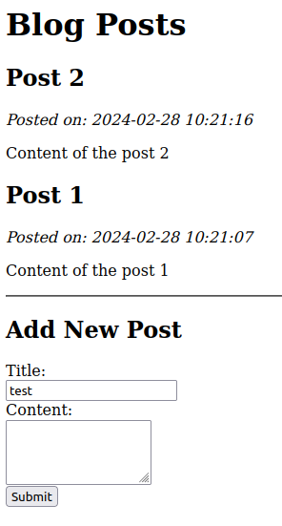
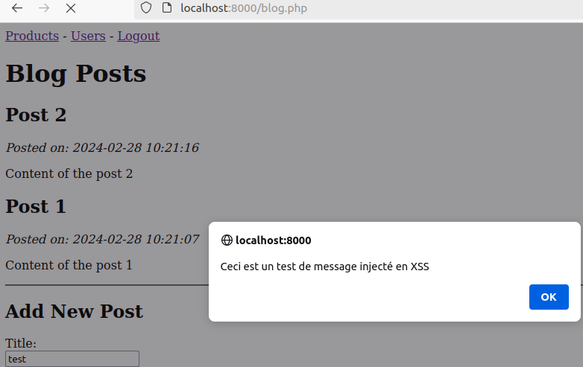
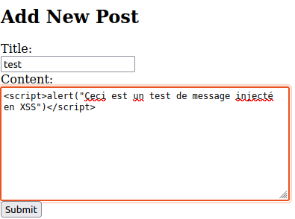
Injection XSS, example
Et alors ? Où est le mal ?

Slide 27
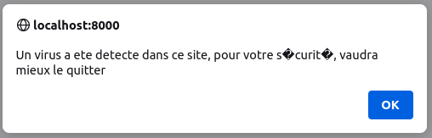
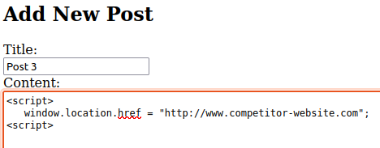
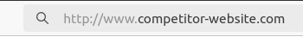
Injection XSS, example 2
Mauvais scénario
Très mauvais scénario
Y a-t-il pire ?

Slide 28
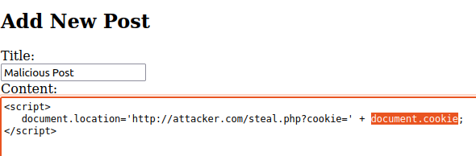
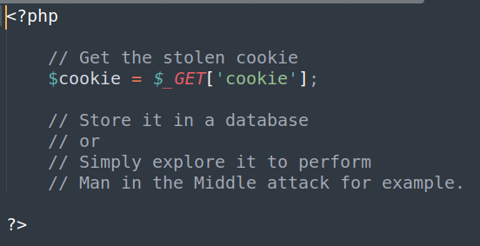
Injection XSS, example 3
Scénario très grave
Attacker file steal.php
If you dig deeper (in JS), you will uncover horrible things you can do using XSS, all you need is to be malicious :)

Slide 29
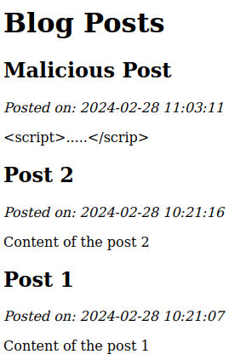
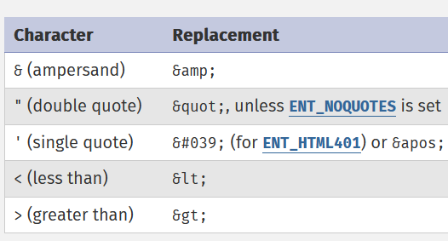
Injection XSS, prevention
Use prepared statement in INSERT Queries
When outputting HTML, use htmlspecialchars like functions.
So easy? No, for more details:
https://owasp.deteact.com/cheat/cheatsheets/Cross_Site_Scripting_Prevention_Cheat_Sheet.html

Slide 30
Vulnerability 5 : Security Misconfiguration

Slide 31
CSRF, what?
CSRF, or Cross-Site Request Forgery, attacks occur when a malicious website or program causes a user's web browser to perform an unwanted action on a trusted site where the user is currently authenticated.
This could be anything from changing email addresses or resetting password, to transferring funds, depending on the functions available in the vulnerable application.
Many modern frameworks include built-in protections against CSRF. But CSRF remains a risk, particularly for legacy systems or systems where CSRF protections aren't properly implemented. It is still a vulnerability that developers need to be aware of and protect against.

Slide 32
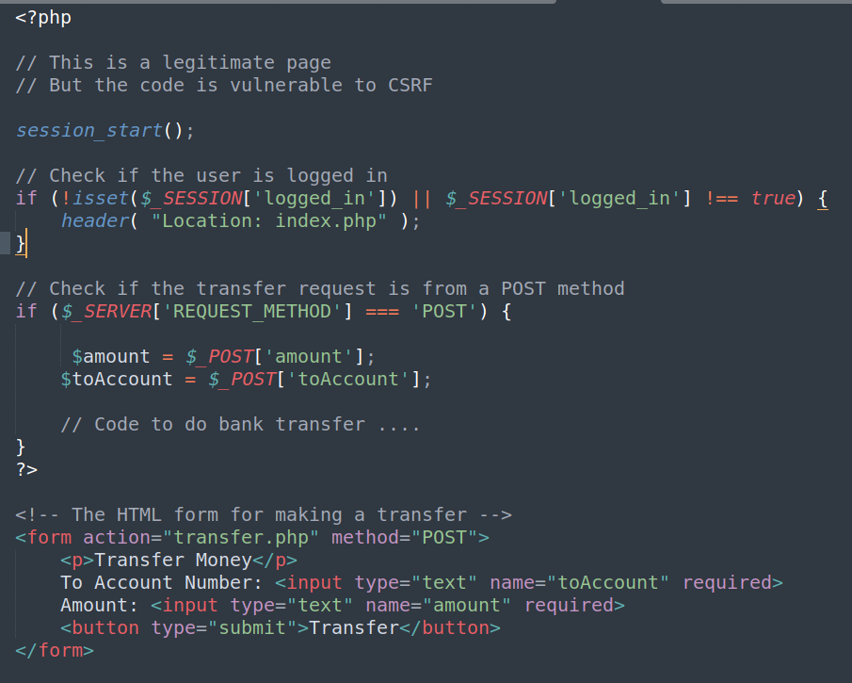
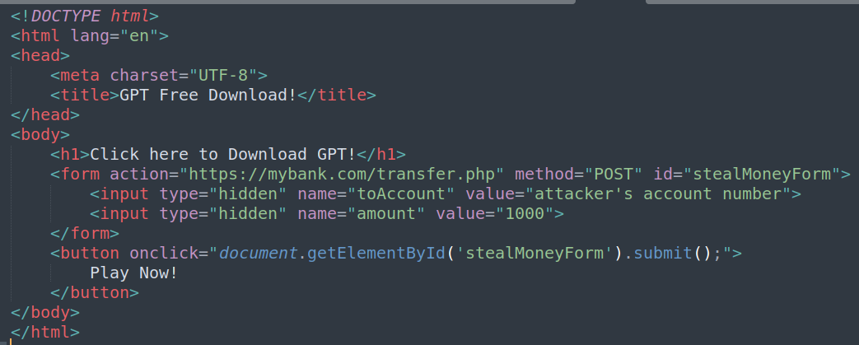
CSRF, examples
https://mybank.com/transfer.php
https://freedownloads.com/gpt.php

Slide 33
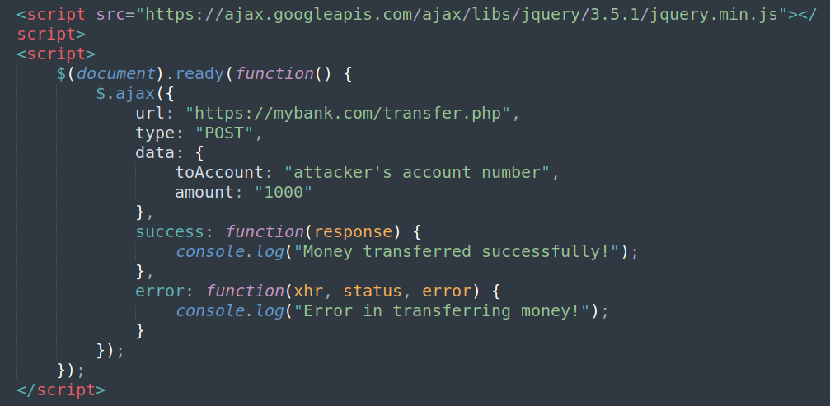
CSRF, examples 2
In Ajax, user interaction is not always necessary. As soon as you land on the page, the Ajax call can automatically execute.

Slide 34
CSRF, prevention
Use Anti-CSRF Tokens: A unique token is generated by the server and included as a hidden field in the form.
Check the Referer Header: By verifying that the request is coming from the same origin.
Require Re-authentication for Sensitive Actions: For actions that are very sensitive (like changing a password or making a payment), require the user to re-enter their password, or use a multi-factor authentication method.
Use Framework-Specific Anti-CSRF Features: Many web development frameworks (like Django, Rails, Spring) have built-in mechanisms to protect against CSRF.

Slide 35
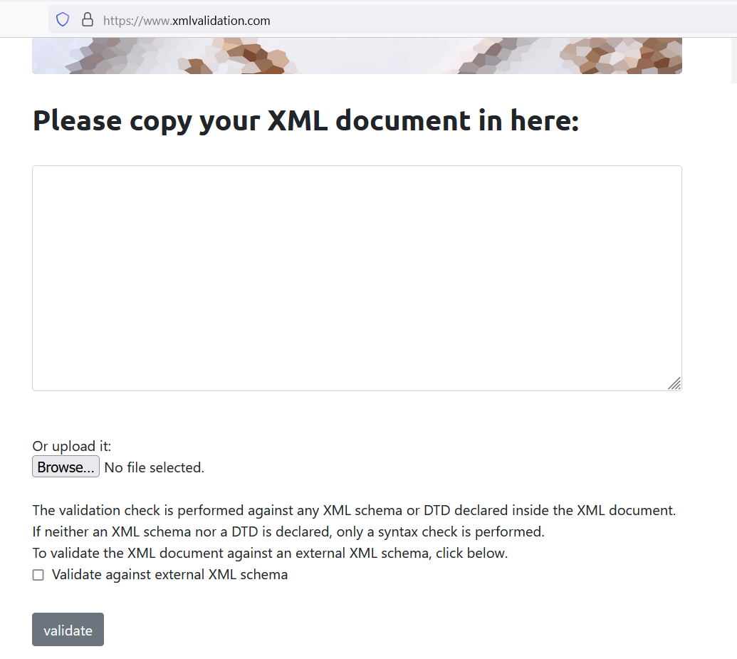
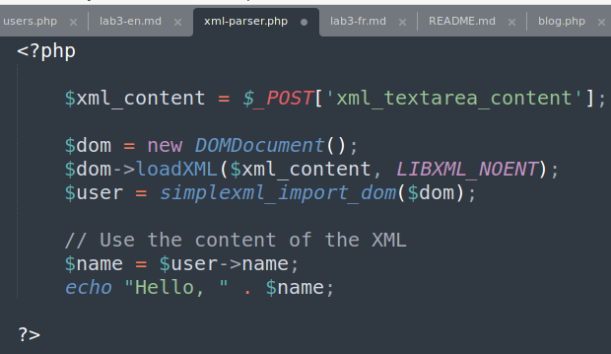
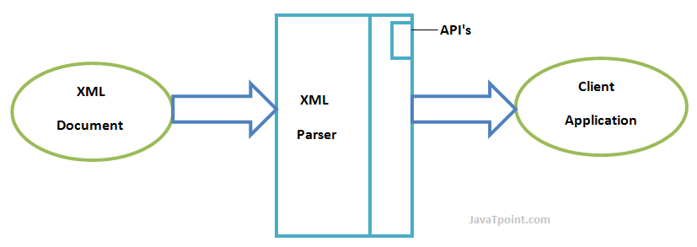
XXE, what?
An XML eXternal Entity (XXE) attack is a type of attack against an application that parses XML input. This attack occurs when XML input containing a reference to an external entity is processed by a weakly configured XML parser.
XXE attacks can lead to sensitive data disclosure, denial of service, server side request forgery, and other system impacts.

Slide 36
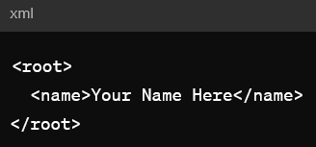
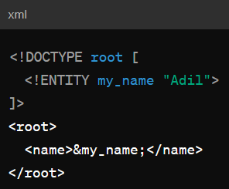
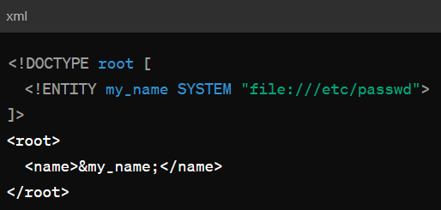
Why this is dangerous?
Safe scenario
Scenario with risk
Malicious scenario

Slide 37
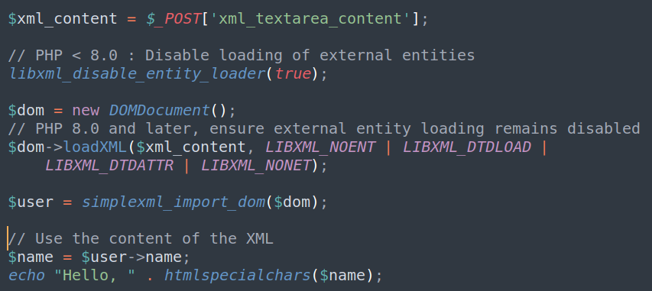
XXE, How to prevent?

